Slide 1

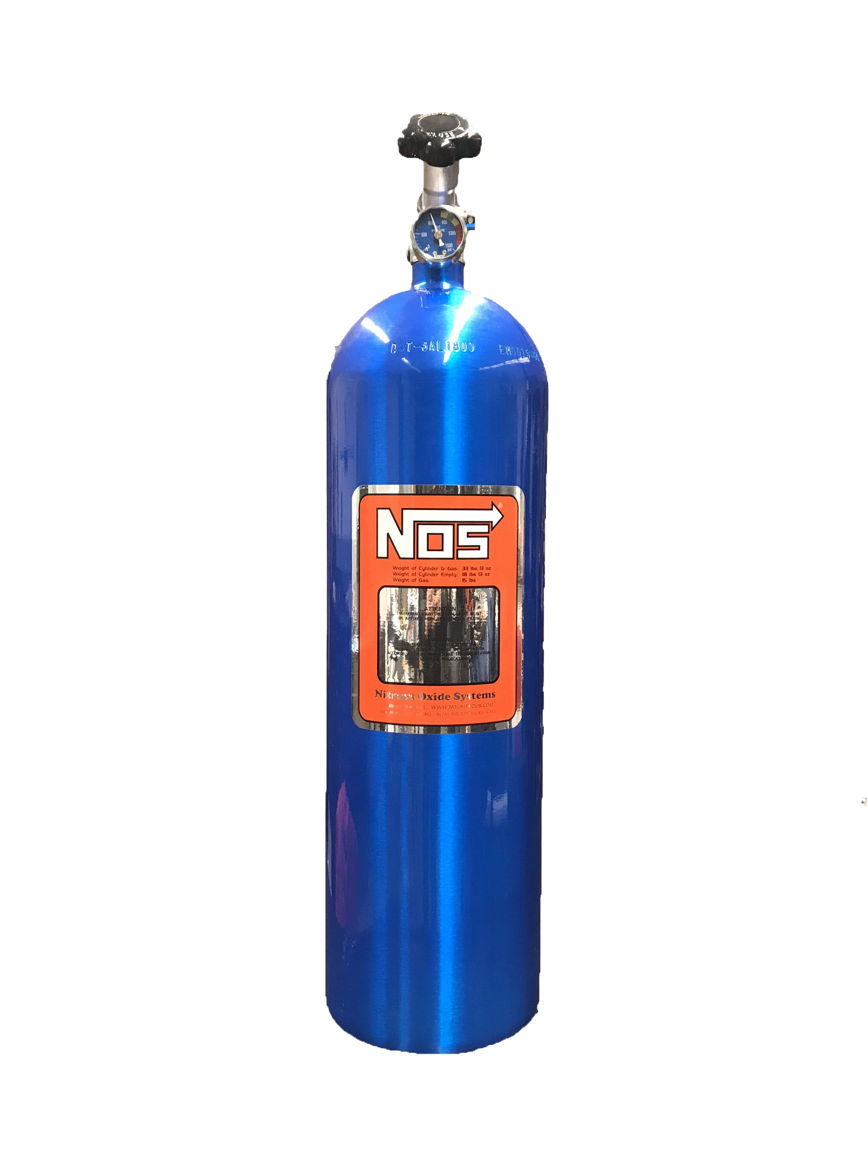



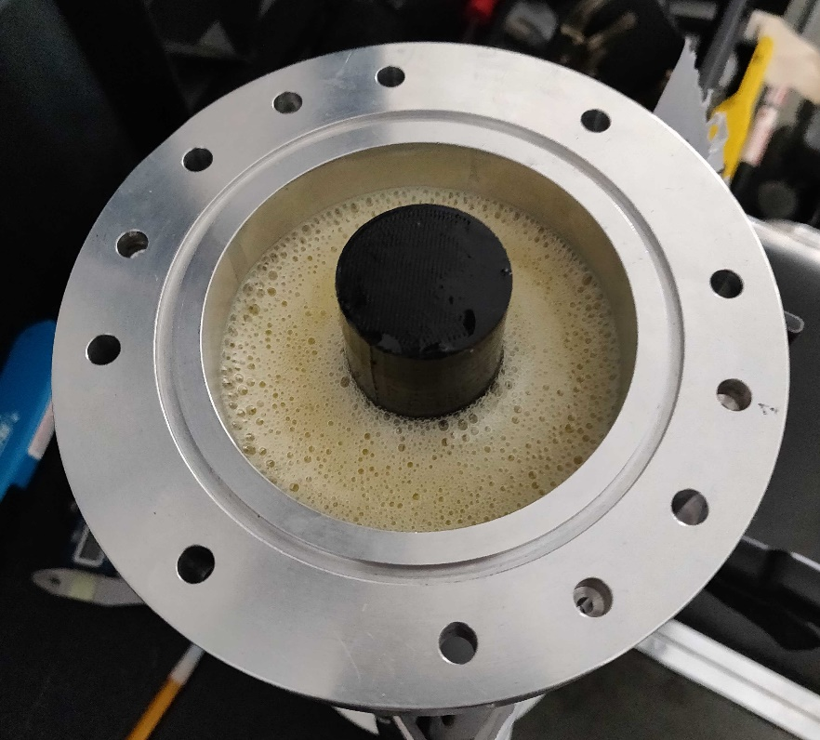
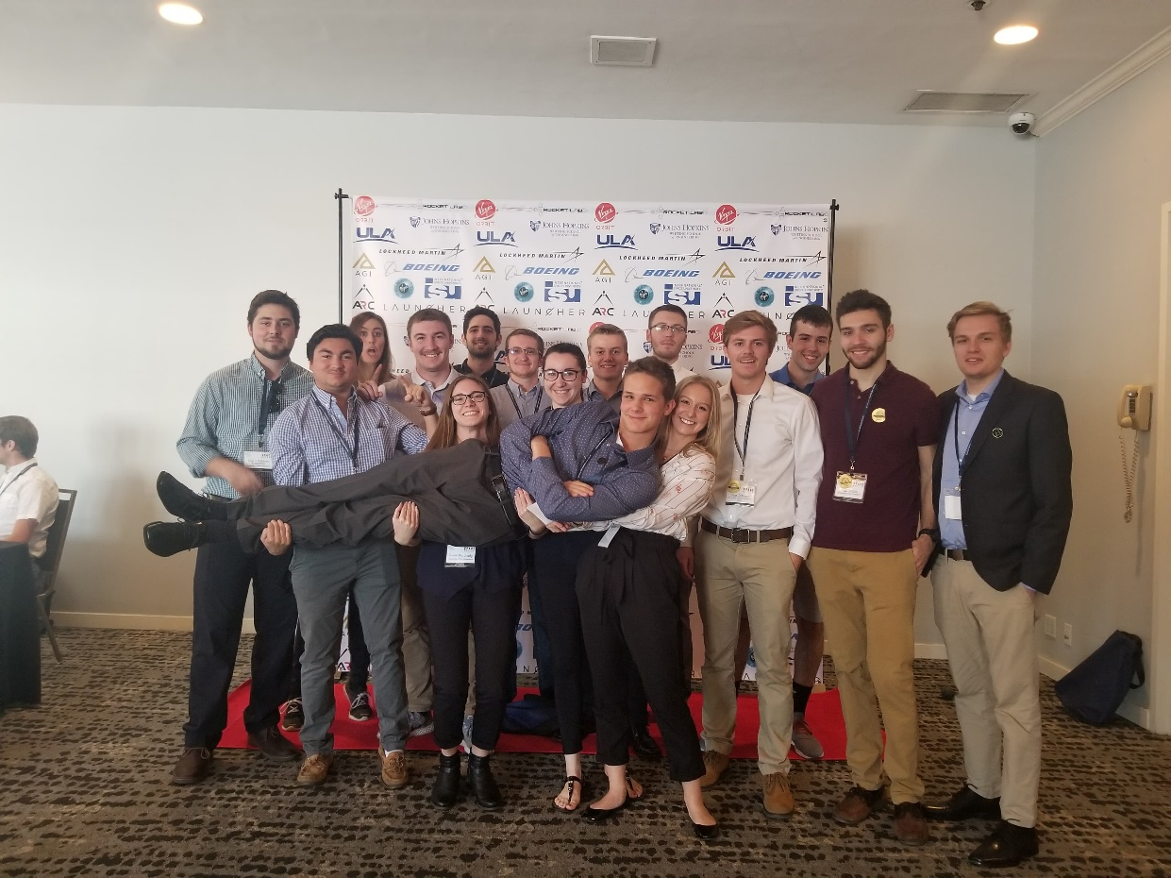

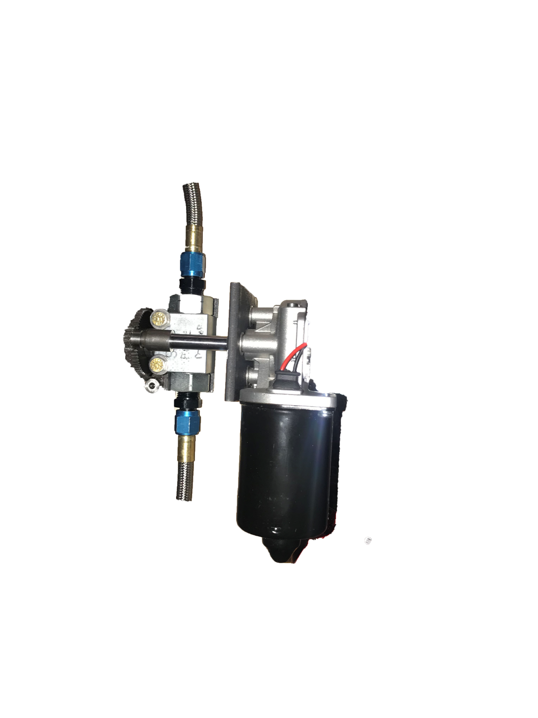
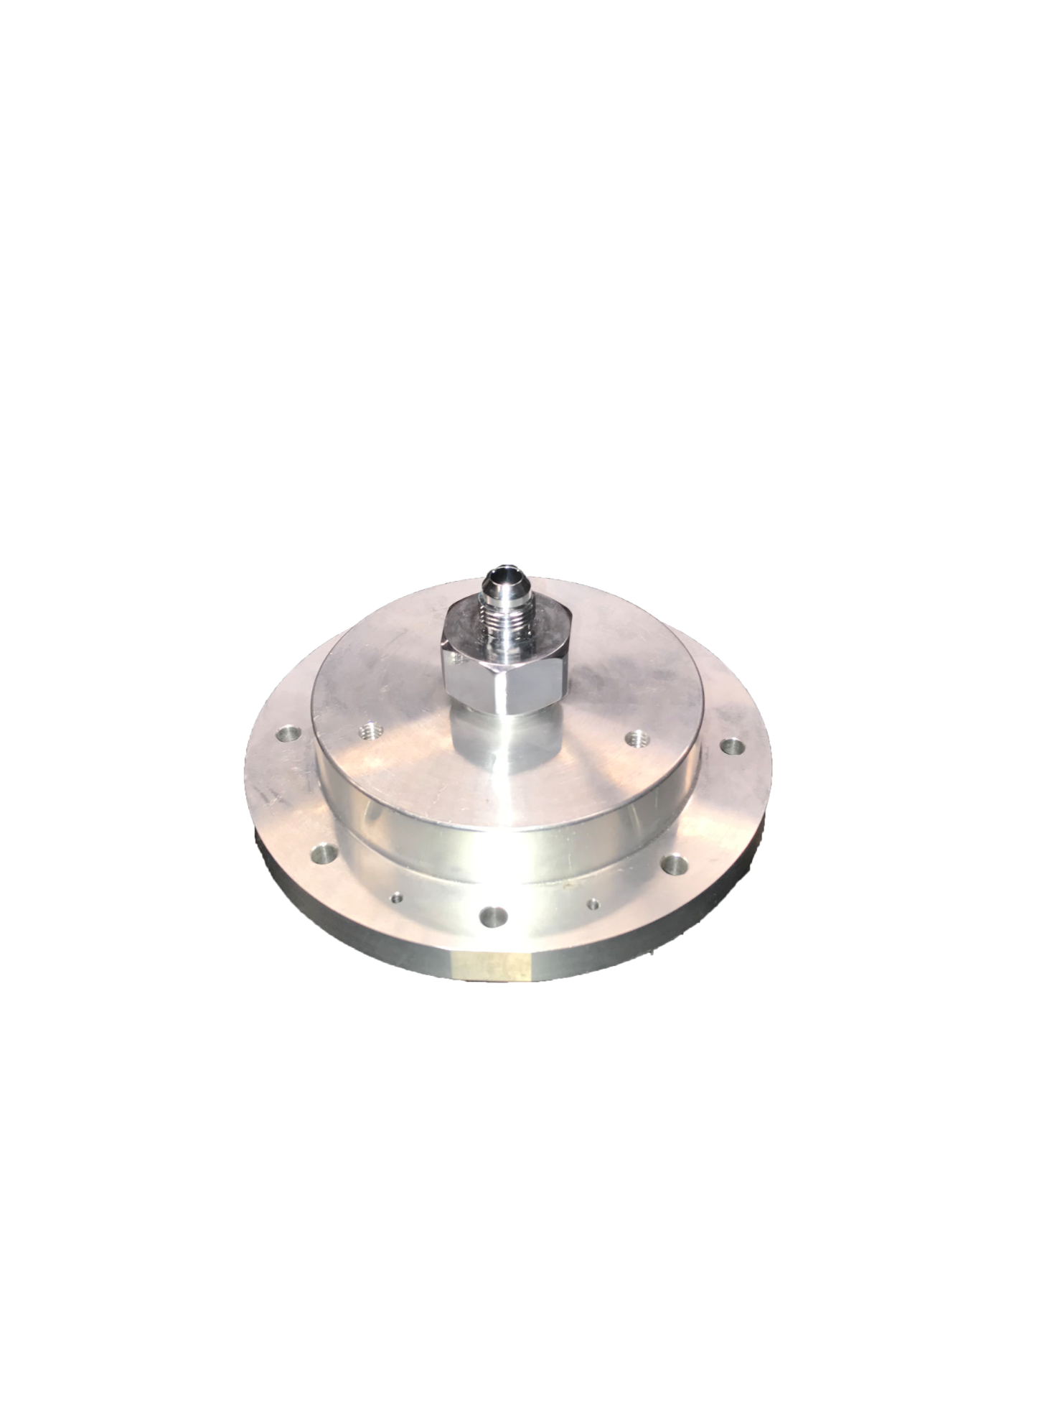
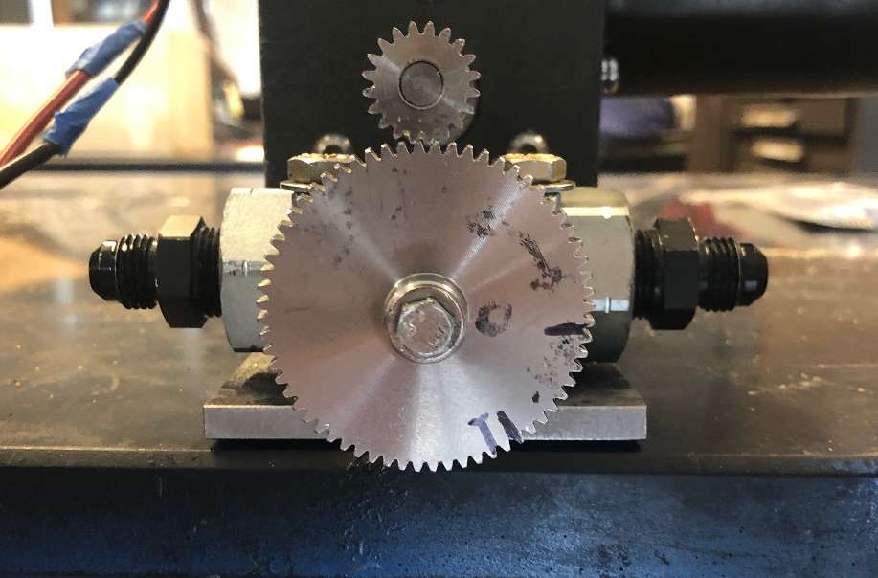
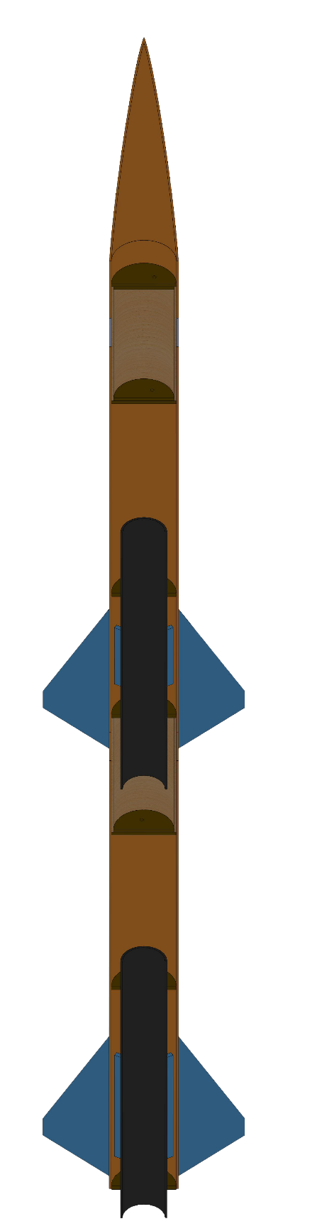
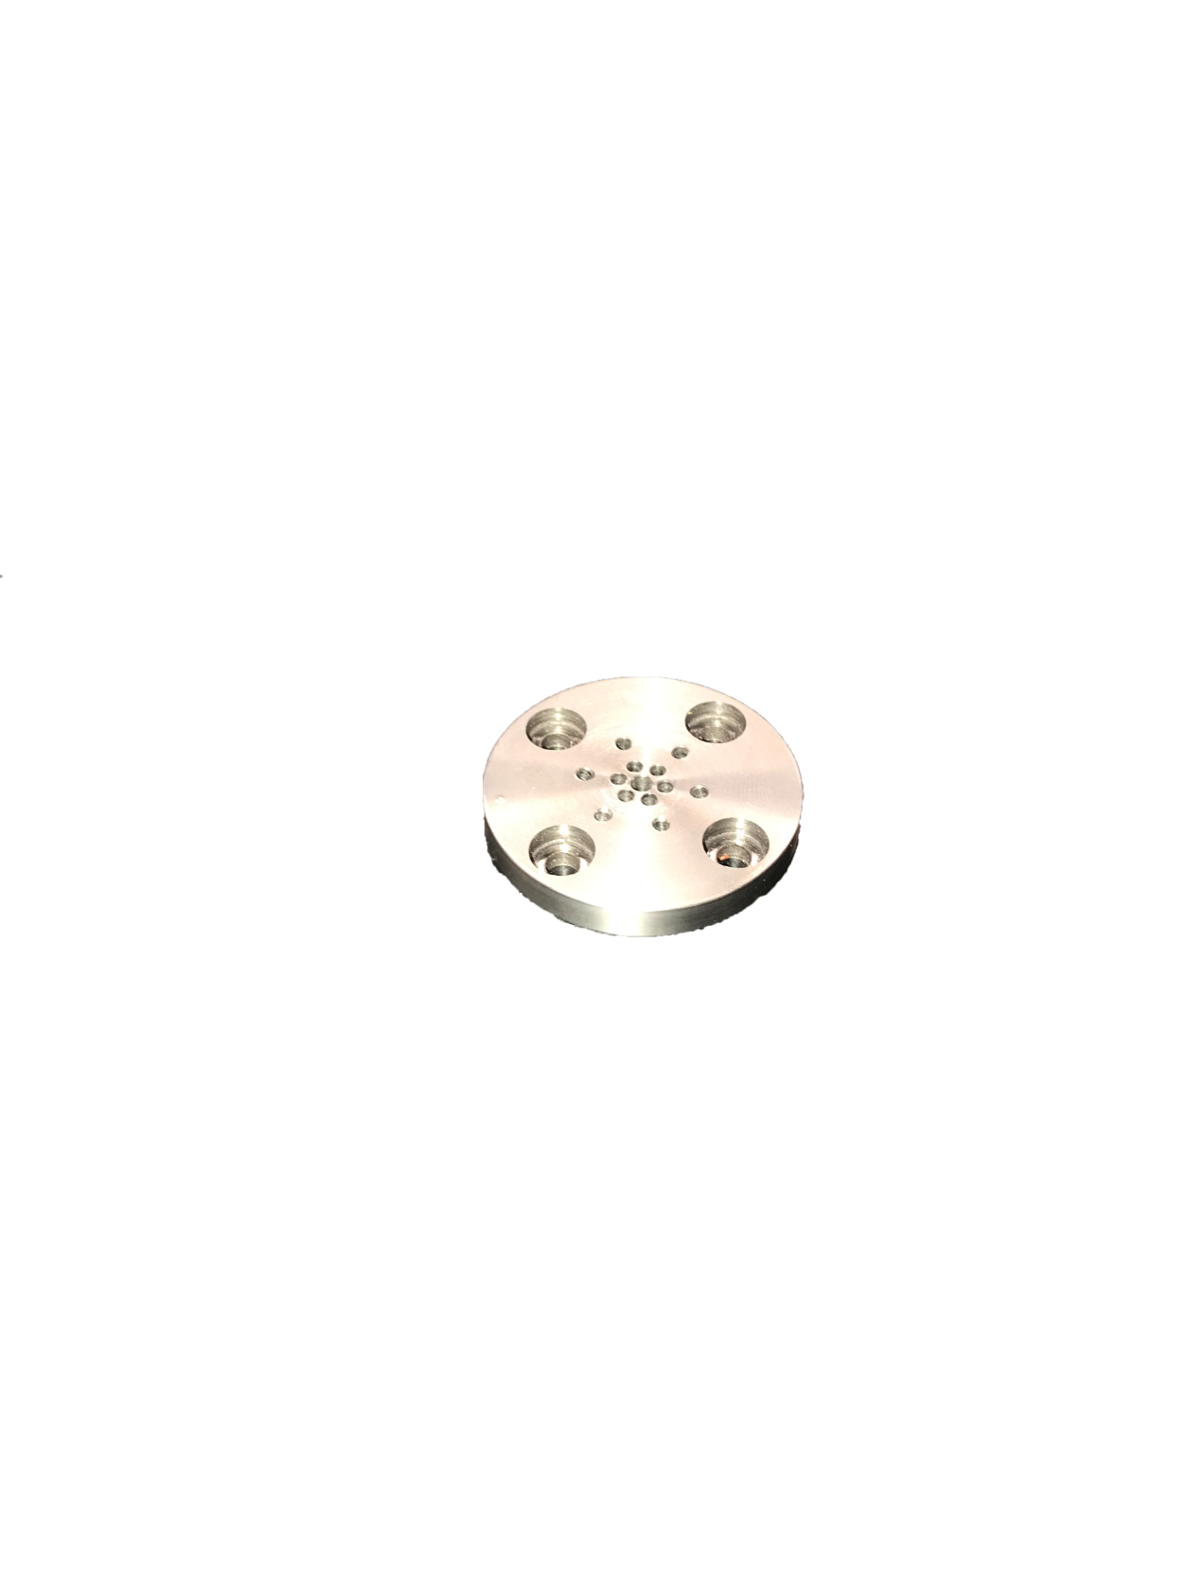


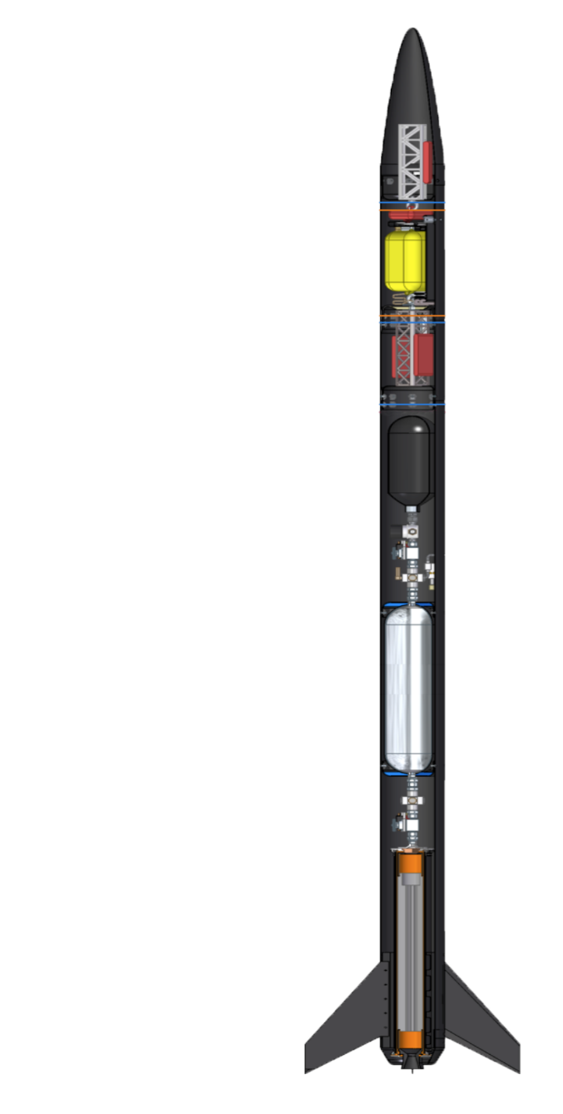
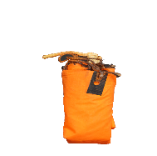
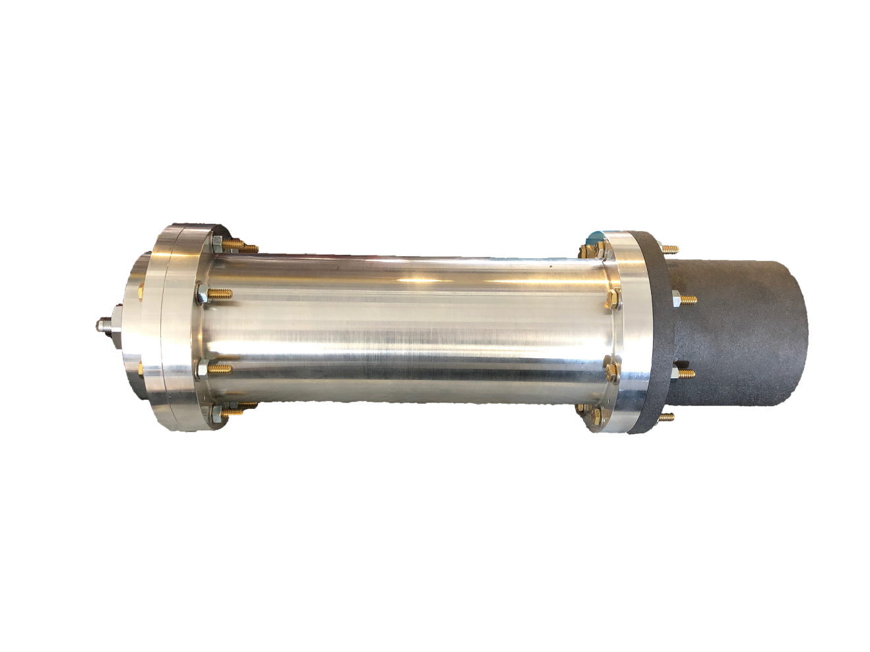
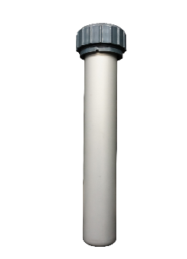
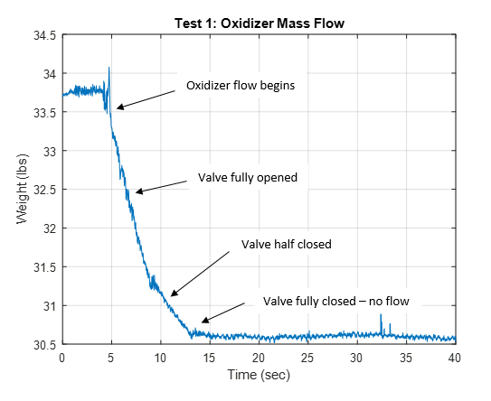
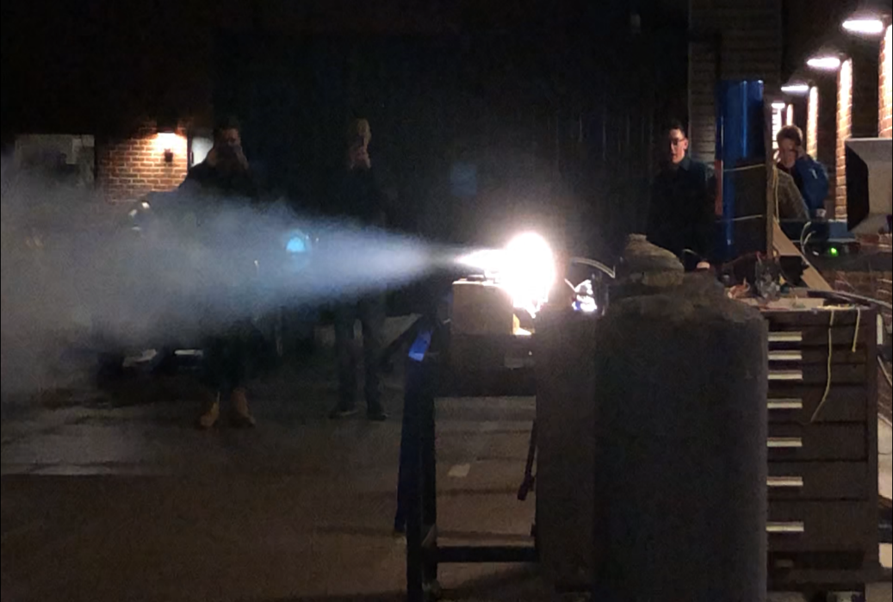
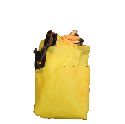
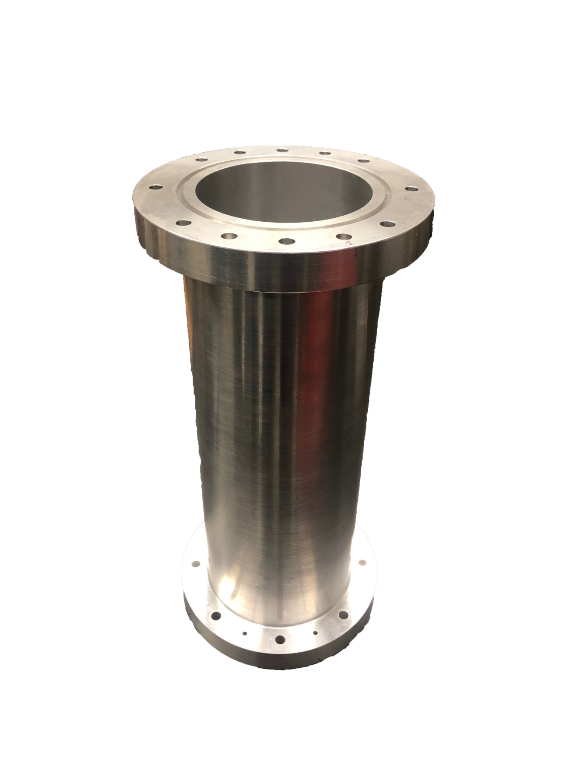
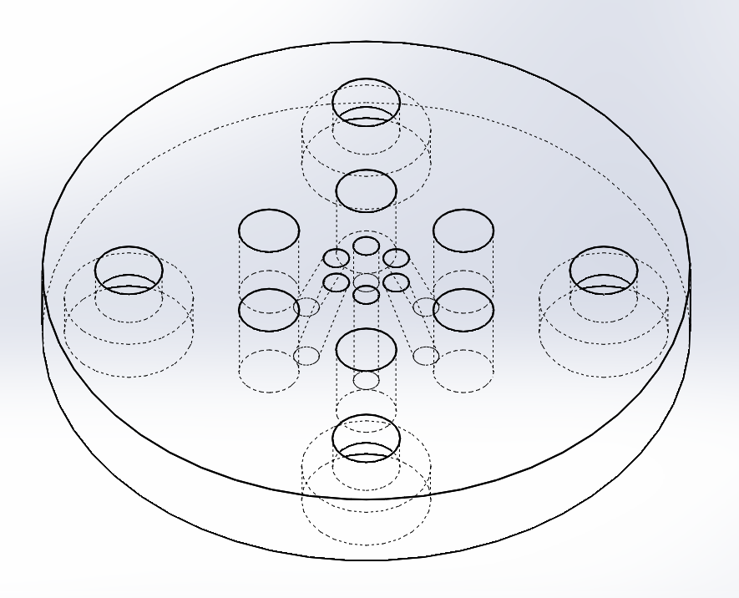

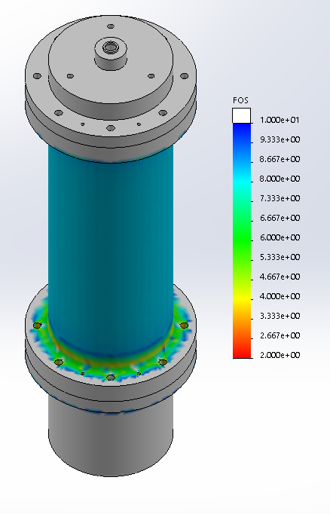
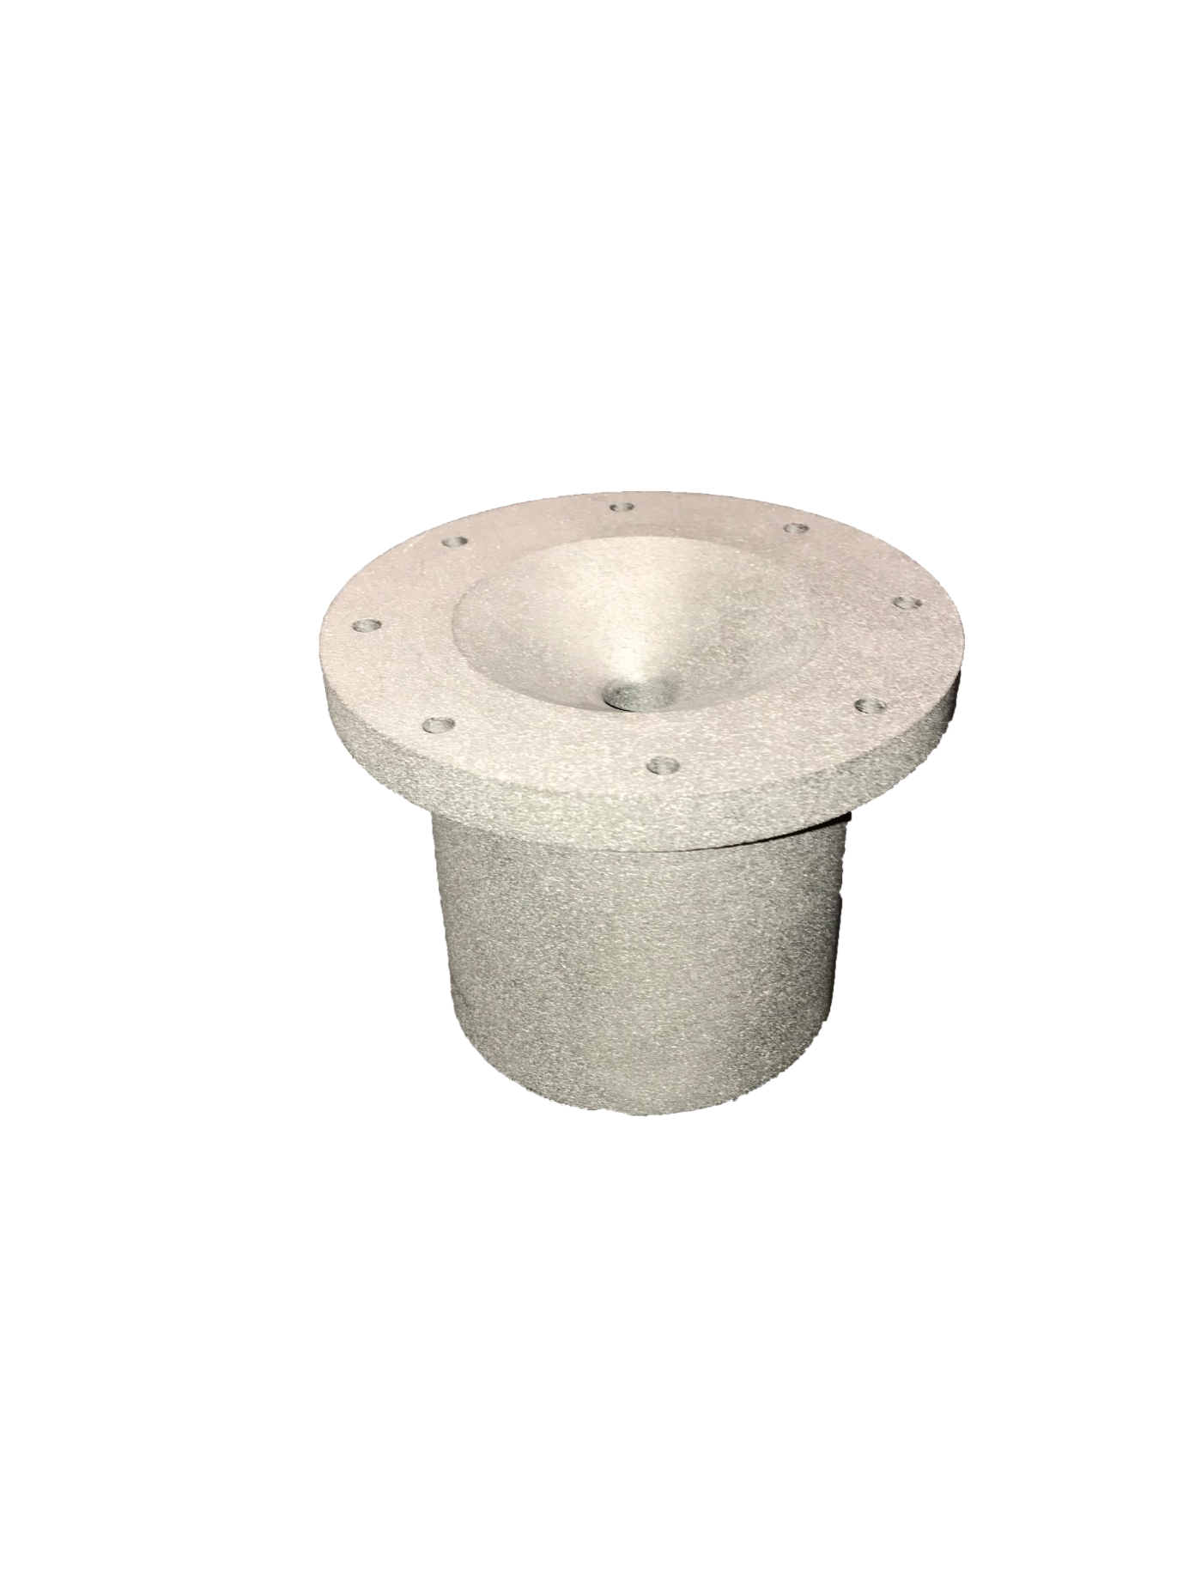
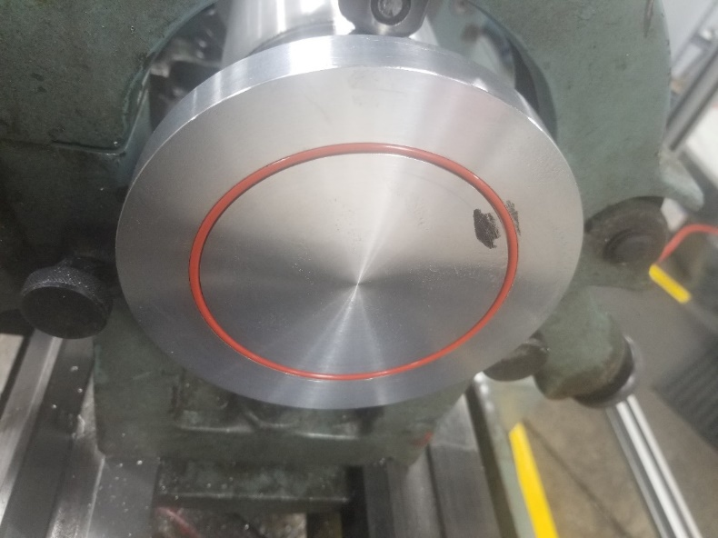
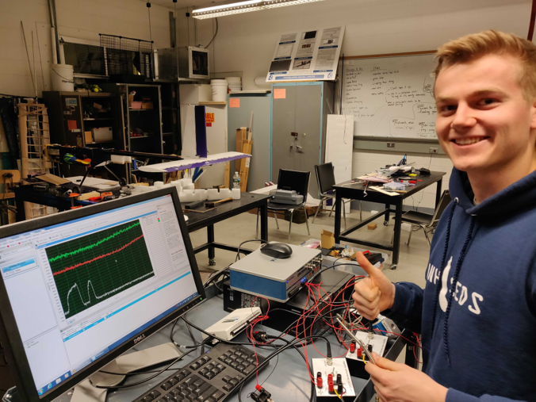
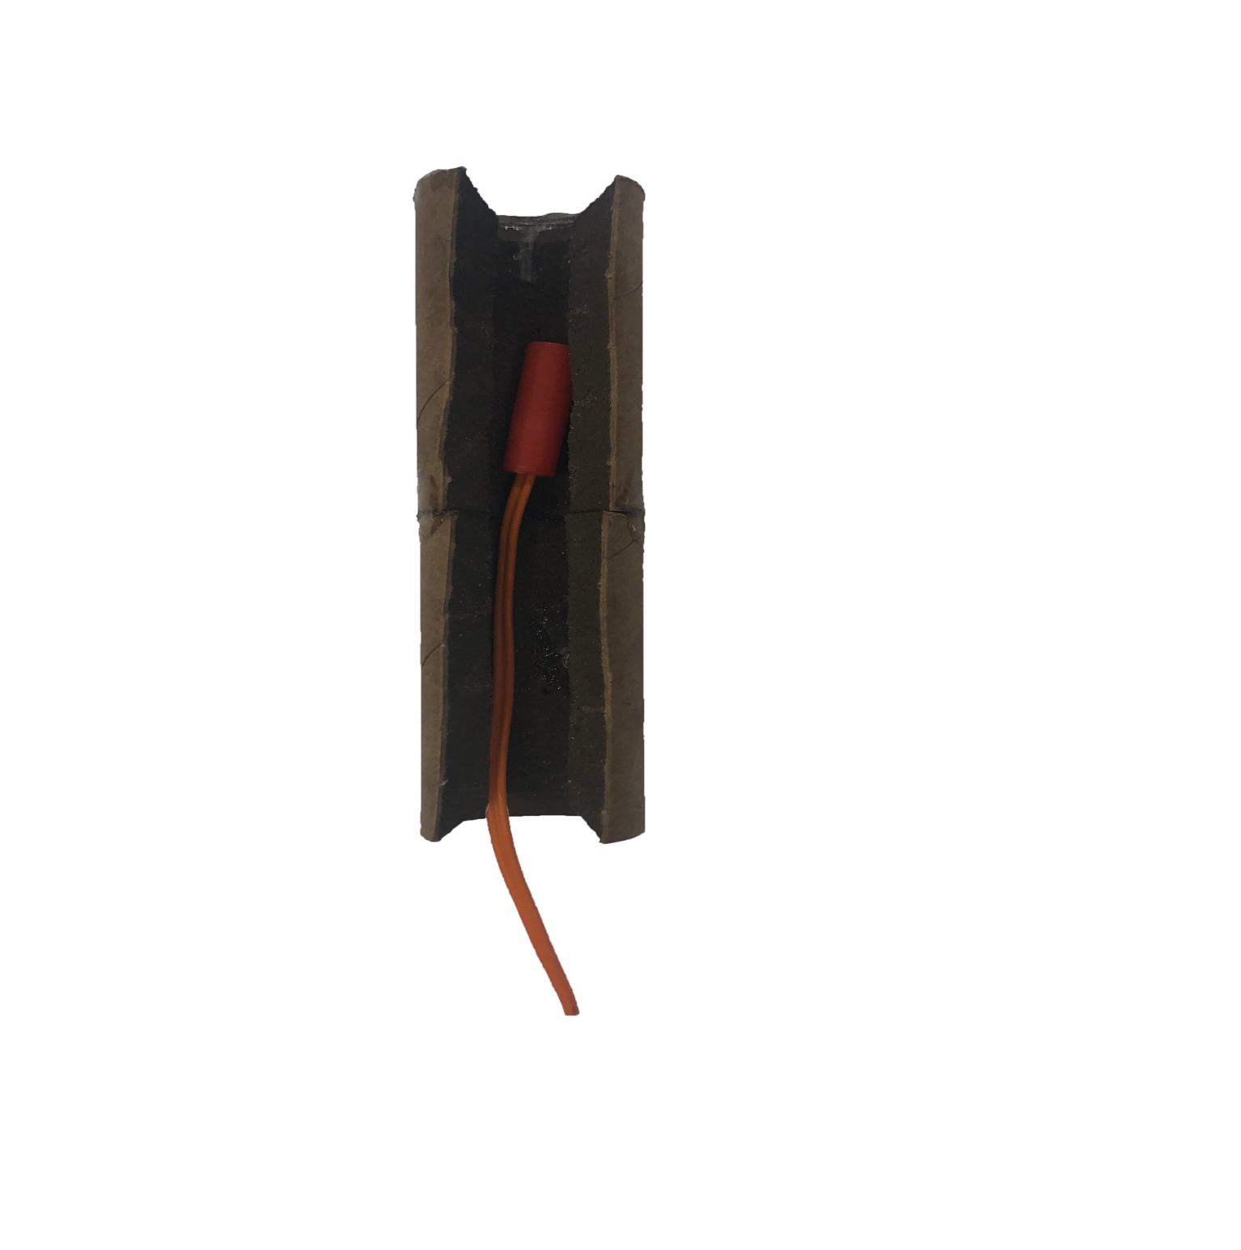


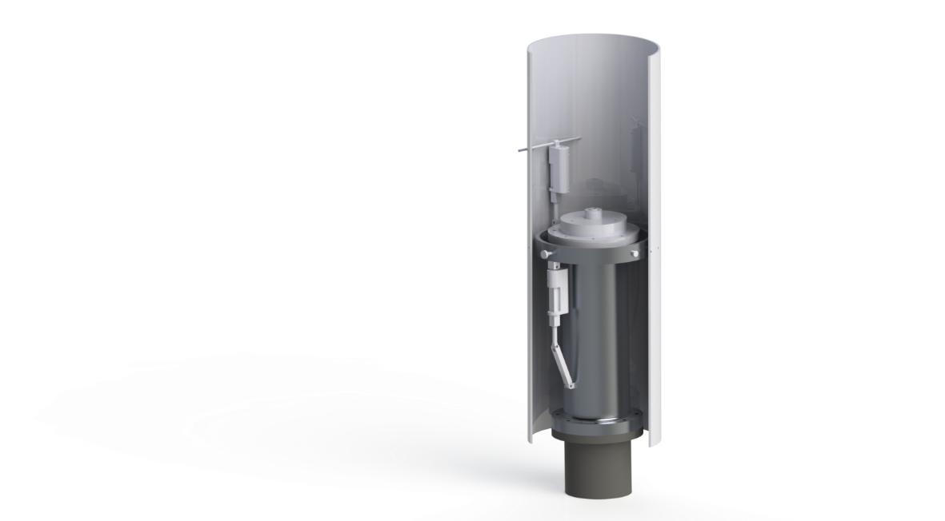
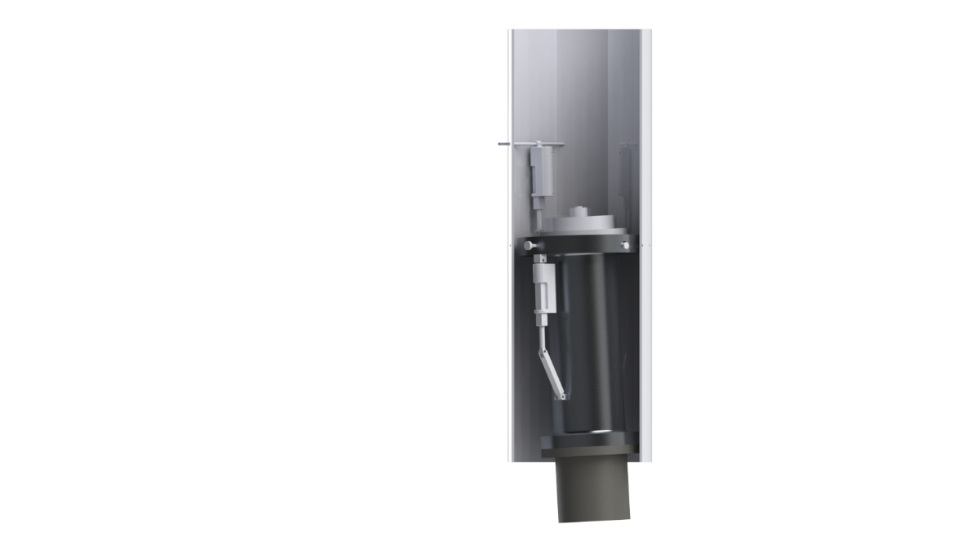
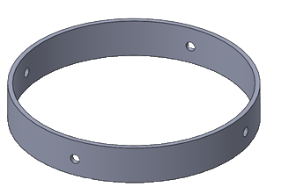
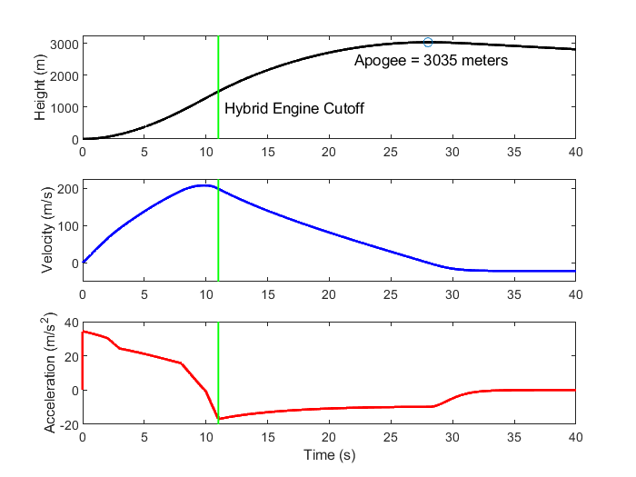
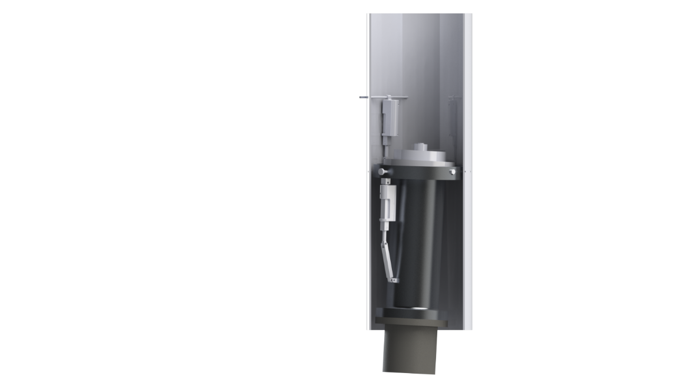
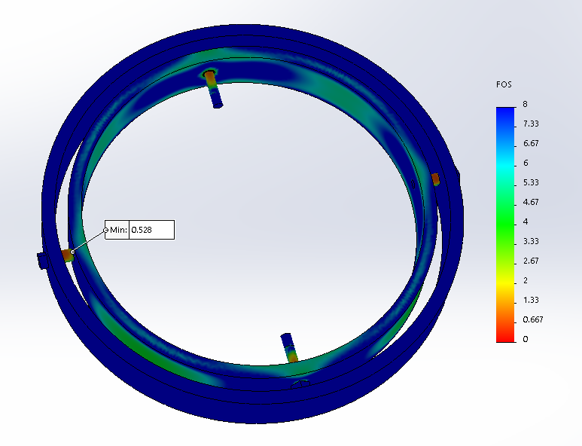
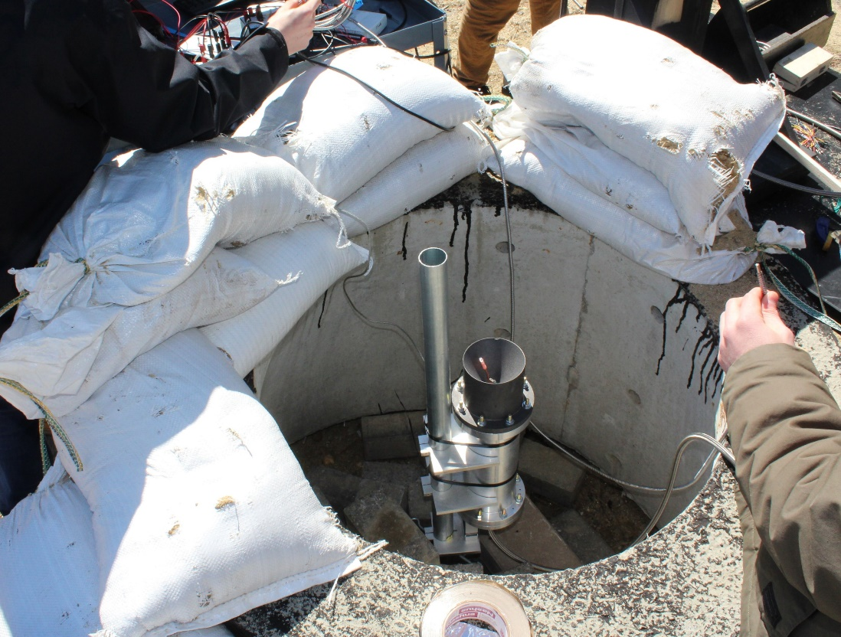
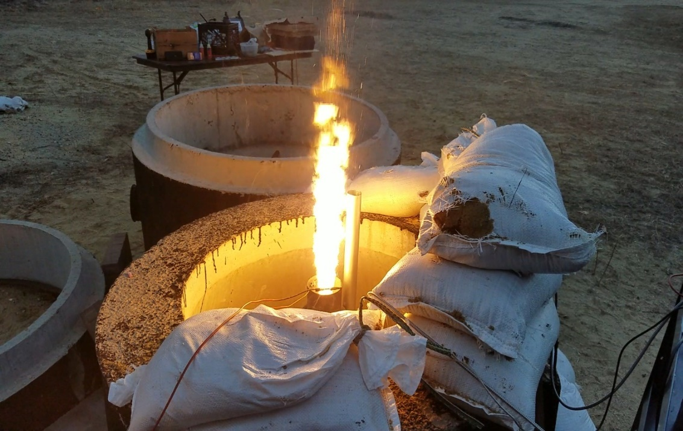
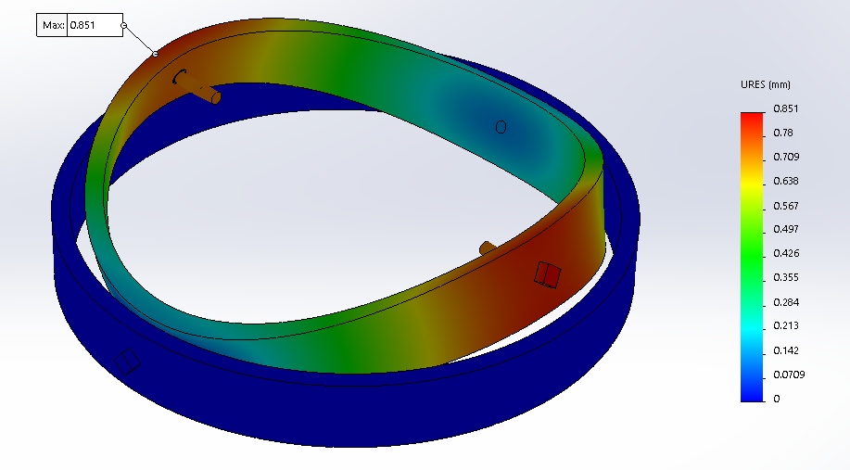
Department of Mechanical Engineering
Authors: Ryan Blatti, Thomas Collins, Chase Eldridge, Andrew Hosman
Silas Johnson, Tyler Landry, John Langer, Charlie Nitschelm, Collin Stroshine Advisor: Dr. Todd Gross
Who We Are
A second year engineering organization comprised of students of all classes and CEPS majors
A primary engineering goal of pursuing the art of high power rocketry with custom-made hybrid engines
Fuel Selection and Flow Regulation
Oxidizer Tank
A highly pressurized vessel that
contains liquid Nitrous Oxide,
acting as our oxidizer within
the combustion chamber
Hydroxyl-terminated polybutadiene (HTPB) and liquid nitrous oxide were chosen as the reducer and oxidizer, respectively.
A mold was 3-D printed to form the HTPB into a circular grain.
Flow Regulator
A motorized valve that monitors flow regulation
of the oxidizer into the injection plate controlled
by an electric motor and
an Arduino.
The flow regulator controls the amount of flow into the combustion chamber, permitting throttle, cutoff, and reignition
SpaceVision, November 2018
SEDS Rocketry Competition, October 2018
The 3 Year Plan
Injection Plate
Responsible for providing desired oxidizer flow into the combustion chamber with the assistance of the impinging plate
Oxidizer Injection
Year One
Year Three
Various impinging plates were designed to be tested for ideal atomization of the nitrous oxide for maximum efficiency within the combustion chamber
Hybrid Engine
Design
Manufacture
Test
A cold fire test was designed to study overall oxidizer flow characteristics and allow a desired oxidizer flow rate of 1.5 lb/sec to obtain an engine burn time of 10 seconds
Impinging Plate
An interchangeable cylindrical plate responsible for the impingement and atomization of the oxidizer flow streams
Runaway
Rocket Building
Simulating
Launching
Optimizing
Hybrid Rocket
Engine Optimization
Rocket Integration
Competition
Combustion Chamber
An enclosed volume where the solid reducer and liquid oxidizer react to produce a superheated, highly pressurized chamber of gas
Year Two
Combustion and Ignition
Hot Fire Test
Incoming nitrous oxide impinges and atomizes saturating the fuel within the combustion chamber producing vast amounts of hot, dense gases.
A river of hot gases flow through the graphite De Laval nozzle, converting its thermal energy into kinetic energy.
Worked with the UNH police and fire departments to locate a safe testing range and procedures.
Test engine to determine thrust, mass flow rate, combustion temperature and overall functionality.
Load cells and thermocouples were used to record data required for future optimization.
Designed and manufactured a static test fire rig to secure the engine and withstand a force up to 500 lbs of thrust.
Three hot fire tests were attempted, but due to weather, failed ignition and flow regulation a successful test has yet to be completed.
Nozzle
Graphite was machined into a de Laval curve responsible for directing the flow of hot gases outside of the combustion chamber into the environment providing thrust
An igniter device is utilized to produce hot gases within the combustion chamber in preparation for oxidizer flow through the impinging plate.
Thrust Vectoring
Current Work
4 steel pins are used to allow rotation of the hybrid engine while maintaining even distribution of thrust to the entire rocket
Improve flow regulation design by reworking gears
Successfully test hybrid engine and work towards an optimum design using STFR V2
Integrate thrust vectoring system onto the propulsion system
Create accurate launch simulations with real-life data from the hybrid engine and rocket geometry
A gimbal ring is used to provide a second rotational piece that is placed between the engine and the rocket body
Acknowledgments
A huge thanks to all the members of UNH SEDS, Scott Campbell, Dr. Ivo Nedyalkov, Dr. Alireza Ebadi, Sheldon Parent, Andy Globe, Dave Emanuel, Chief Dean, Ronald O’Keefe, TURBOCAM International, Reilly Webb, the UNH Makerspace and our advisor Dr. Todd Gross for all the support
Two actuators positioned 90 degrees apart enable real-time pitch and roll control

